Slide 1




Slide 2




Founded in San Francisco in 2008
Founders:
Brian Chesky, Nathan Blecharczyk, Joe Gebbia
Over 6,000,000 listings in 191 countries and 81,000 cities

Slide 3

Background
Airbnb listing sampled data for Singapore, with approximately 7.9K listings by different hosts.
The dataset provides information about the listing as well as the price.

Slide 4
Objectives
Using the provided data, create a findings report about the different airbnb listings in the region and any interesting patterns of listing you may find.
Identify the key factors impacting the price of the listing using a combination of data exploration and linear regression methods

Slide 5
Outliers & Calculated field.
Outliers:
Reviewed zscores and box plots to remove outliers. On further inspection, used a lower outlier limit for price.
Removed outliers for other variables based on zscores.
Calculated field
I assigned numbers to room type and neighbourhood group to create a dummy variable
# of reviewed/ reviewed per month = how long this apartment has been on airbnb

Slide 6
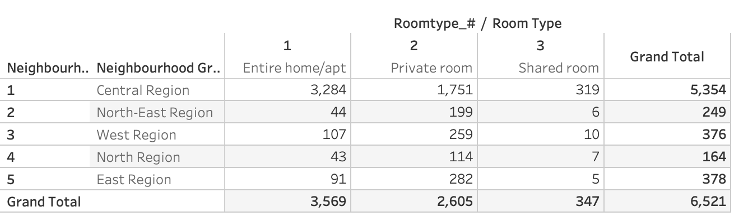
Category Overview
Hypothesis: Different Region will have different quantity of room availability
We found out that the majority of the rooms are located in Central Region. Most of the rooms are Entire home/apt. There is very little shared room in all region.
We should be promoting Entire home/apt as a strategy for Airbnb.

Slide 7
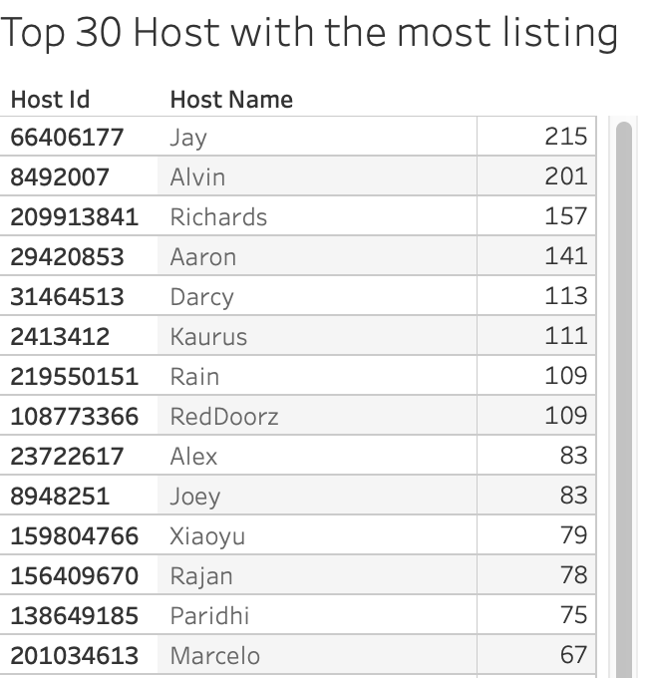
Top 30 Host
Hypothesis: Host with more apartments will become more popular as they are experienced host
Surprisingly, Some host have over 200 listing. I think the top 20 host might be a third party company. Airbnb should look into this and understand why such things happened and avoid competition in the future
Notes:
yun

Slide 8
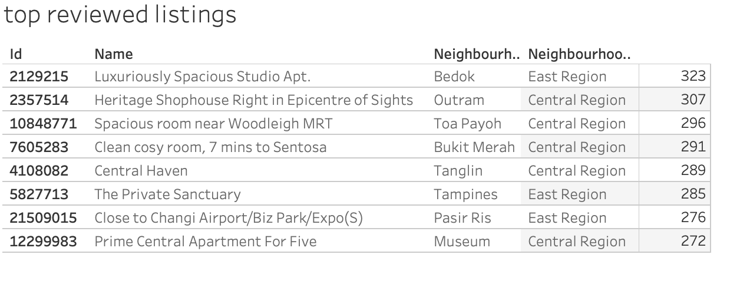
Top Reviewed
Hypothesis: Apartment with certain attribute might attract customers to review them
Looking at these names of the apartment, the first apartment have 323 reviews which is pretty high. Words like Luxurious, Heritage, spacious will track more reviews. Therefore, Airbnb can suggest host to have adjective to their name to attract more customers

Slide 9
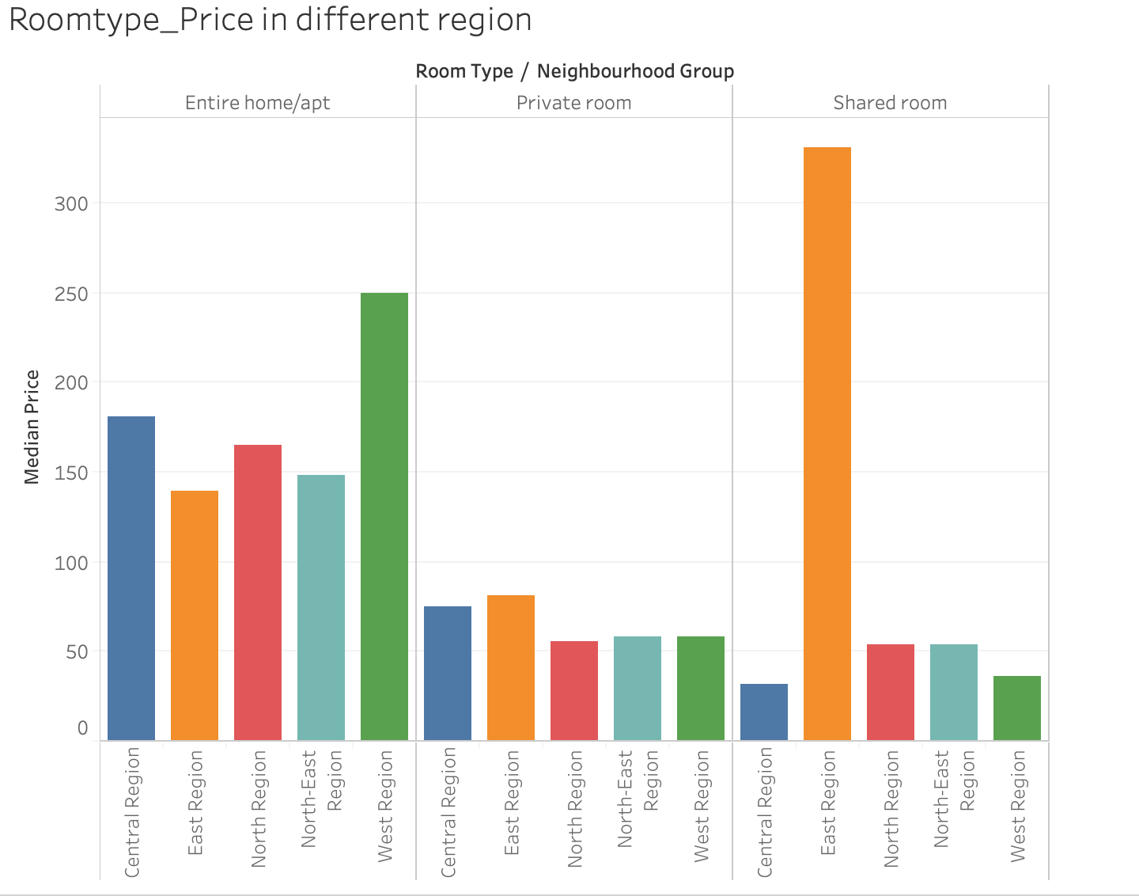
Roomtype_Price
Hypothesis: We think that different locations will have a different median price. For example, the housing price in Manhattan will be different for those in Montana
Although share room in East region is way over the top, when we look at the data, we did not exclude them as outliers because we do not know how many people can that room accomandate.
In General, Central and East were able to charge a high price. Entire home is able to charge a higher price compare to private room and shared room

Slide 10

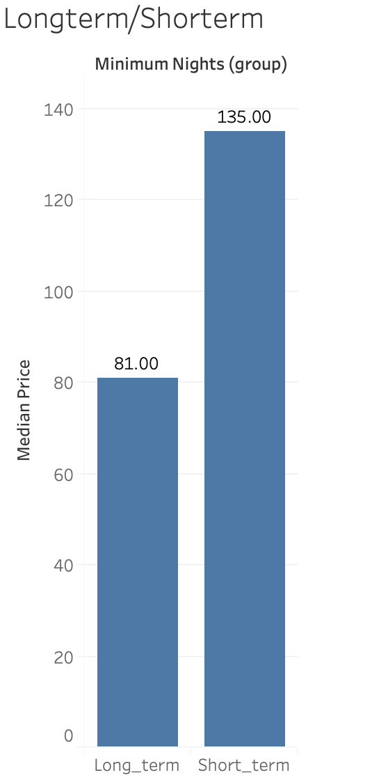
Long Term/Short Term Stay
Hypothesis: Short term stay will affect a higher price.
I define short term stay with days less than 2 months (60 days)
I found out that short stay charge a median price of $135 and long term stay charge a median price of 81 which is a pretty significant differences. Significance checked using z test in python code.

Slide 11
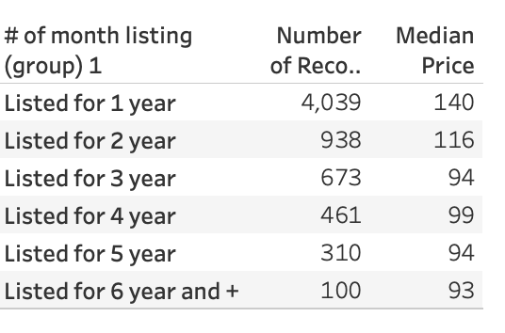
# of month been listed
Hypothesis: I think the longer it has been on the airbnb list, the higher price they should charge because they are more experienced
By looking at these groups. Most listings are created less than a year. However, is able to charge a higher price.
Therefore, it rejected my hypothesis and we need looking into the data to find out if total reviews /reviews per month = total month listed.

Slide 12
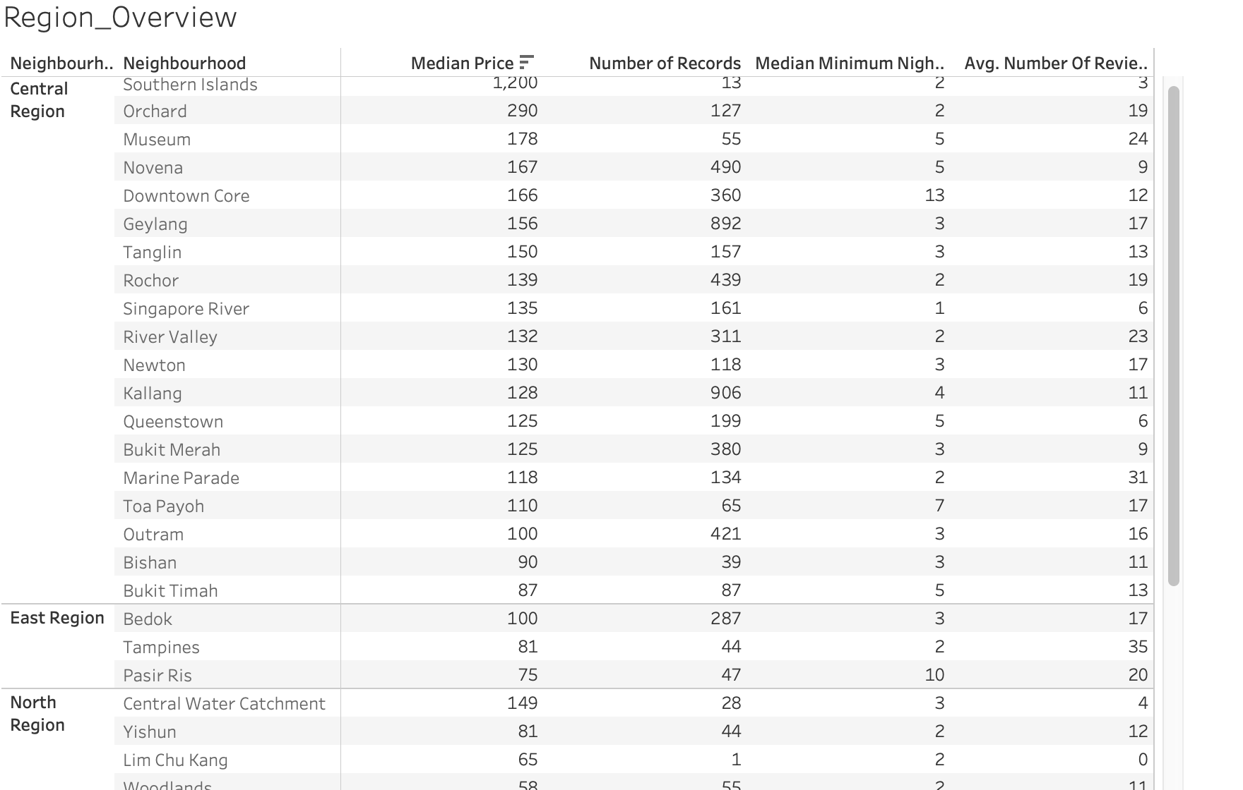
Region Overview
Hypothesis: We think that different locations will have a different median price.
Some locations in certain region will have a higher median price. For example in central region, southern islands have a median price of 1200. This means that this is probably in equivalent to the upper east side of New York.

Slide 13
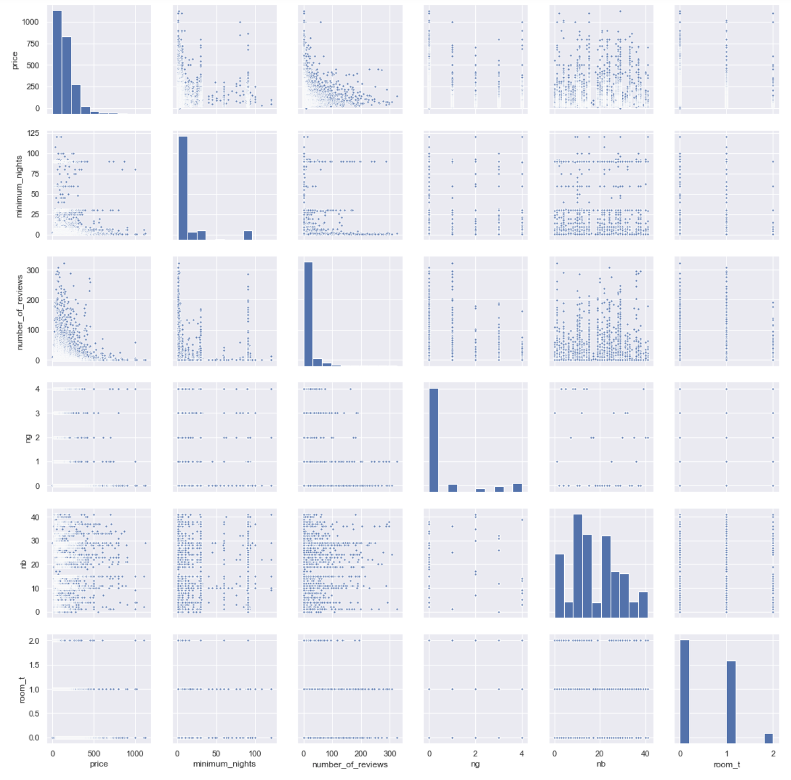
Correlation
It seems like room type and price may have a specific relationship as room 2 on visual inspection room type 2 seems to have a lower price index than other room types. to be checked if this relationship is significant.
There also seems to be a relationship between review count and price, indicating that lower priced listings get more review. but this relationship is probably because of the availability factor.
Before doing more inferential stats tests, I will create basic model and see what it outputs and how well it predicts

Slide 14
Additional Data that could help improve the analyses
More data on how many people can be accommodated
Provide reviews rating in order to understand if this is a good host or not.
Show how many people have booked this apartment instead of reviews
Understand the host’s review and the apartment reviews in the same time.
Double check if # of reviews/ reviews per months make sense.

